Slide 1

D10X Hackathon: supply side shock
Ver 1.1 Comm Labs

Slide 2
Problem statement
Supply Side Shock detection for traders to provide time advantage for monetization.
Delay of Event news appearing in Mainstream Media. No system for flashing that relevant news
Identifying relevant unexpected news from the enormous information available on Social Media.

Slide 3
Our Advantages
Product Functionality
Value for Clients
Speed
Intelligent scoring from smart search
Identify hidden signal and Cut through the noise of unstructured data to get a tailored content feed.
Scalable
Optimized and scaled using Big Data / Cloud
Adaptability
Small and light weight application.
Integrated in Citi Velocity.
P&L
Oil tanker sabotage event on 12 May 19 made traders $500,000
Brazil dam burst ,Iron ore event 25 Jan19 cost the team $17 million

Slide 4
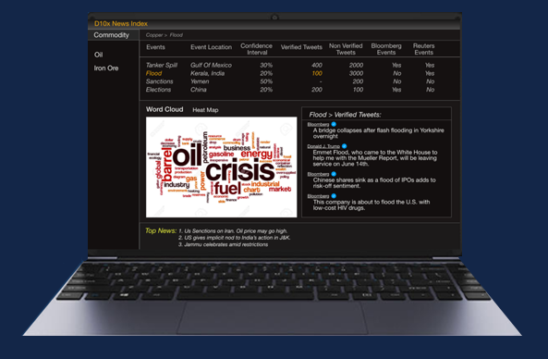
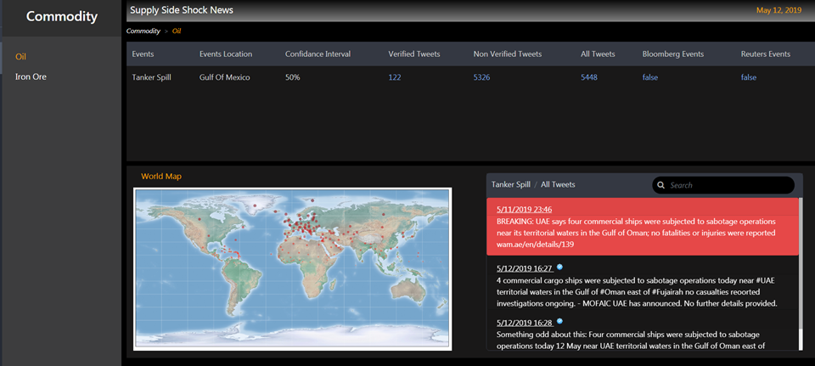
COMM Lab Offering
Confidence Score for Alert with filter to calibrate the false positives.
Tweets from Non Verified and Verified sources
News from Bloomberg and Reuters
Commodities
Top Tweets
World Map
https://qa.citivelocity.com/comm-lab/#

Slide 5
Social Media News Extraction NLP Pipeline
Creating Word- embedding's and Tweet relevancy Detector
Approach 1: Count Vectorizer, TF-IDF
Approach 2: GloVe embedding
Approach 3: BERT embedding
Generating Summary
Sort text on the basis of Text Rank Score and Engagement score.
Pick top text whose score is greater than threshold
Arrange texts in the order they appear in original data.
Stage 1
Stage 3
Stage 5
Stage 2
Stage 4
Data Cleaning and Preprocessing (Derived from traders provided keywords.)
Removing extra character and Stop words.
Extract mentions, retweets, emoji's, First Order Pronouns, links etc.
Tokenize text into sentences
Text Rank Algorithm
Create similarity matrix of sentences using cosine similarity
Apply Text Rank Algorithm
Evaluation
Calculate Confidence Score
Aggregating 10+ features 1.Reach metric which talk about people 2.Impression metric which talk about event impact
3.Engagement score
4.User Wtd. account age 5.Relevancy score, 6.following/follower ratio 7. emoticons score
8.Regency score etc.
All values in [0-100.]

Slide 6
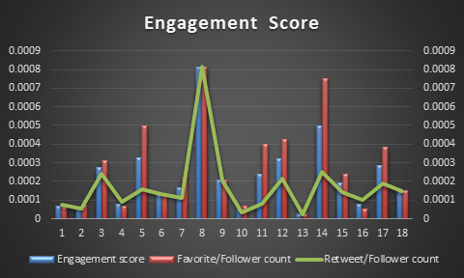
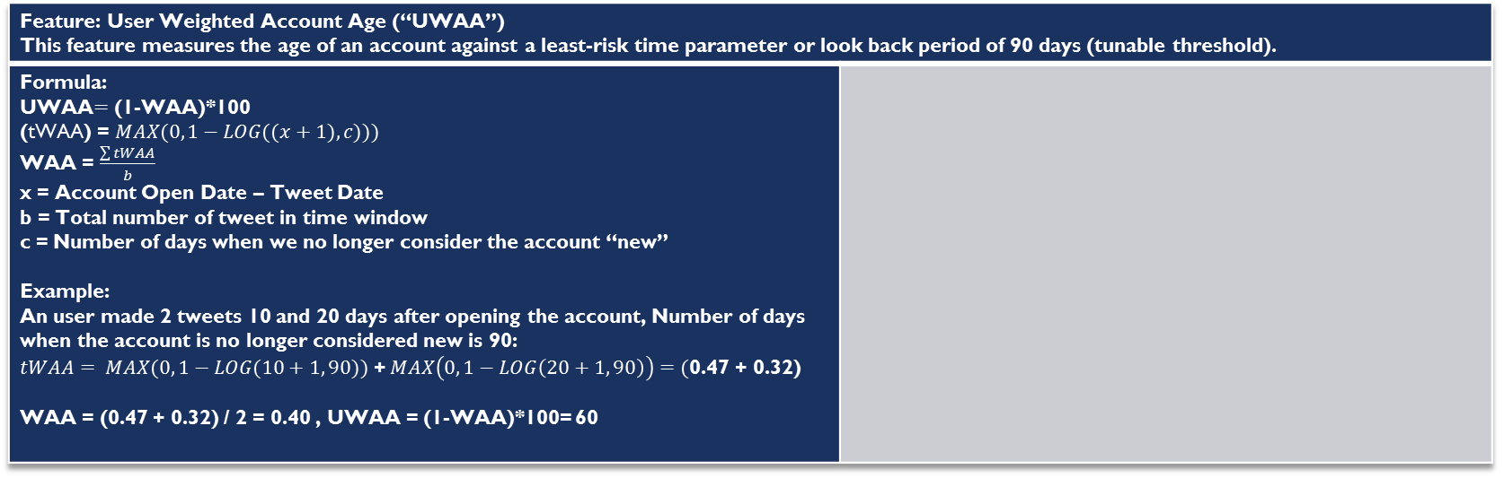
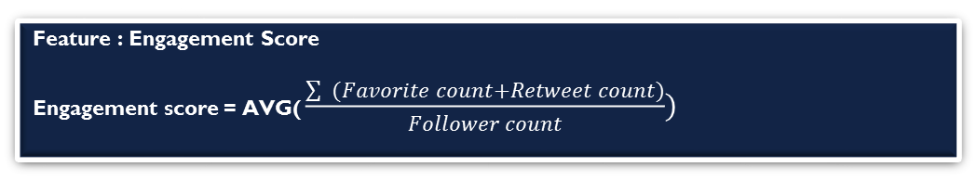
Metrics - Confidence score derived from features
Feature : Engagement Score
Engagement score = AVG( $\frac{\sum{ (Favorite count+Retweet count)}}{Follower count})$
Feature: User Weighted Account Age (“UWAA”) This feature measures the age of an account against a least-risk time parameter or look back period of 90 days (tunable threshold).
Formula: UWAA$=$ (1-WAA)*100 (tWAA) = $MAX(0, 1−LOG((x+1),c)))$ WAA = $\frac{\sum{tWAA}}{b}$ x = Account Open Date – Tweet Date b = Total number of tweet in time window c = Number of days when we no longer consider the account “new” Example: An user made 2 tweets 10 and 20 days after opening the account, Number of days when the account is no longer considered new is 90: $tWAA= MAX(0, 1−LOG(10+1, 90))$ +$MAX\left(0, 1−LOG\left(20+1, 90\right)\right)=($0.47 + 0.32) WAA = (0.47 + 0.32) / 2 = 0.40 , UWAA = (1-WAA)*100= 60
Feature scores lower the closer tweet is in time frame between the day the account is opened and 90 days.

Slide 7
Assumptions
Mock up data is used for MVP purpose.
Processing of bulk data need Big data cluster

Slide 8
RISK
Real Time Social media feed will be available in Citi environment.
Mitigation
Onboarding Live Feed in AWS box , getting it verified by CATE for security and compliance.

Slide 9



Traders/Clients Details before demo
Simon Kelly
VP ,Commodities Technologies
Andrew Hunt
Director Trader, Oil
Mark Muston
VP, Base Metals
Nirav Parikh
Director Futures Sales

Slide 10








Team Details
NLP
ML
UI / UX
Team Lead, Senior Data Scientist
Akshay Jain
Shiv Kushwaha
Architect
Streaming
Vikas Sawant
Shakeel Korbu
Eklavya Sharma

Slide 11
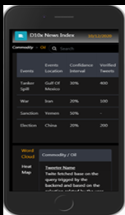
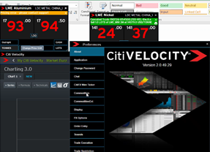
FUTURE EXTENDABLE PRODUCT
Multi Lingual and Multi Commodities Capability
Scalable to Citi Velocity Mobile app which is good for offline hours
Test flight : IOS need Apple id and SSO UAT password.
Android App install: https://uat.citivelocity.com/cv-content-web/storage/cvandroid/eppublic/file/cv-uat.apk
Message sharing capability in app.
A floating screen with buzzer on trader window in CV 2.0.
Feedback mechanism to optimize the feature weights in the model .
https://uat.citivelocity.com

Slide 12
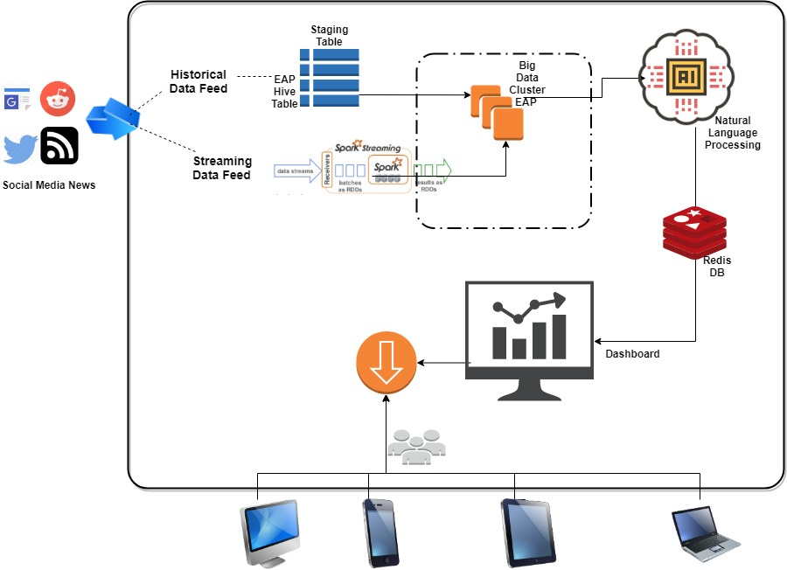
Architecture
High Level Architecture Flow

Slide 13
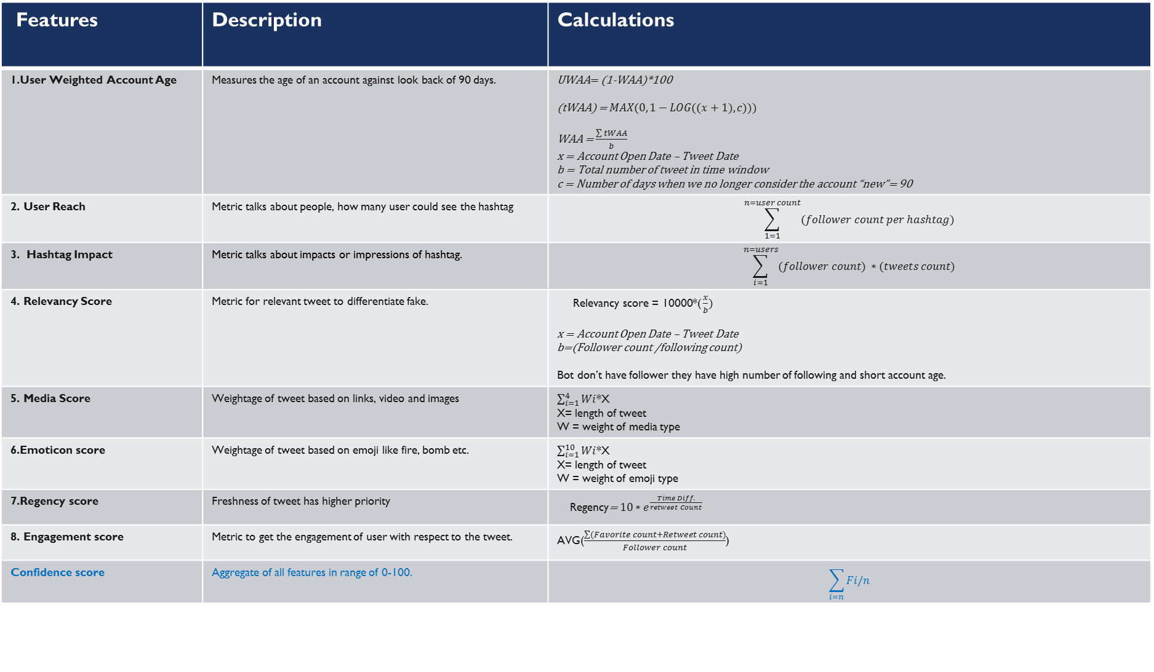
Features | Description | Calculations
1.User Weighted Account Age | Measures the age of an account against look back of 90 days. | UWAA$=$ (1-WAA)*100 (tWAA) = $MAX(0, 1−LOG((x+1),c)))$ WAA = $\frac{\sum{tWAA}}{b}$ x = Account Open Date – Tweet Date b = Total number of tweet in time window c = Number of days when we no longer consider the account “new”= 90
2. User Reach | Metric talks about people, how many user could see the hashtag | $$\sum_{1=1}^{n=user count}{(follower count per hashtag)}$$
3. Hashtag Impact | Metric talks about impacts or impressions of hashtag. | $$\sum_{i=1}^{n=users}{(follower count) ∗(tweets count)}$$
4. Relevancy Score | Metric for relevant tweet to differentiate fake. | Relevancy score = 10000*( $\frac{x}{b})$ x = Account Open Date – Tweet Date b=(Follower count /following count) Bot don’t have follower they have high number of following and short account age.
5. Media Score | Weightage of tweet based on links, video and images | $\sum_{i=1}^{4}{Wi}$*X X= length of tweet W = weight of media type
6.Emoticon score | Weightage of tweet based on emoji like fire, bomb etc. | $\sum_{i=1}^{10}{Wi}$*X X= length of tweet W = weight of emoji type
7.Regency score | Freshness of tweet has higher priority | Regency= ${10∗e}^{\frac{Time Diff.}{retweet Count}}$
8. Engagement score | Metric to get the engagement of user with respect to the tweet. | AVG($\frac{\sum{(Favorite count+Retweet count)}}{Follower count}$)
Confidence score | Aggregate of all features in range of 0-100. | $$\sum_{i=n}{Fi/n}$$

Slide 14

Thank You
Comm Labs Team

Slide 15

Lean Canvas
Comm Lab
06-SEP-2019
Problem
Supply shock detection
Delay of Event news appearing in Mainstream Media
Identifying relevant event news from the humungous information available on Social Media
Existing Alternatives
Bloomberg news, Google alert and Reuters news feeds.
Watch lists, filters on social media
Verbal communication between brokers
Solution
Gather social media data to create a time advantage for traders to monetize.
Apply NLP Model for relevant news based on traders provided keywords and performing back testing on provided events.
Dashboard to deliver Event news.
Unique Value Proposition
Powerful UX to deliver crisp and concise timely event information for traders to optimize the profit opportunity.
Configurable and scalable architecture with Citi Velocity integration.
Small and Light weight application.
Unfair Advantage
Innovation in the Natural language processing model.
Integration within Citi Environment
Customer Segments
Traders
Early Adopters
Commodity Traders specifically:
Oil trader
-Iron Ore
Channels
Trader referrals
- Citi Velocity integration can help expand across Citi.
Key Metrics
Confidence Intervals [0-100 range]
Engagement score.
Weighted account age=
x =Tweet time diff from account creation.
$$MAX(0, 1−LOG((x+1),90)))$$

Slide 16
Appendix
References:
EIKON REUTERS APPLICATION AND SUPPORT TEAM
https://developers.refinitiv.com/
Iron Ore event earlier this year cost the team $17 million, tool to detect this early could have significantly reduced this
https://www.reuters.com/article/us-vale-sa-production/vale-second-quarter-iron-ore-output-falls-33-8-following-brazil-january-dam-break-idUSKCN1UH1EL
Oil event made $500,000 when trader heard about it early from a broker
https://en.wikipedia.org/wiki/May_2019_Gulf_of_Oman_incident

